Slide 1
Android NDK Build Flow Guide
Native Development Kit (NDK)

Slide 2
Outline
Installation
Android
JNI built by NDK
Native Remote Debugger
Current has issue in 64-bit
Demo

Slide 3
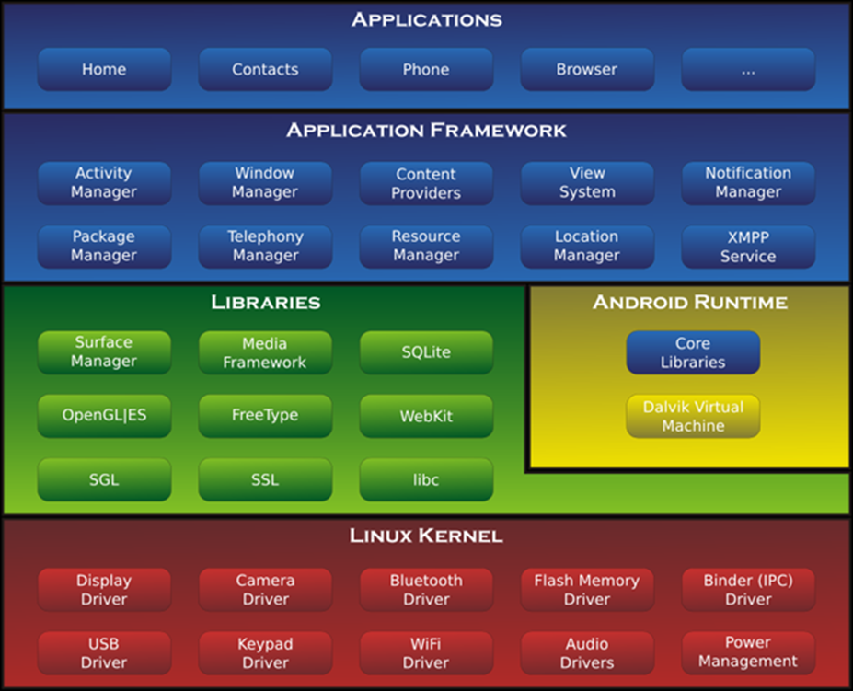
Android
An intent-based client-server architecture
Java
Dalvik VM

Slide 4
Why NDK ?
Because some existing applications written in C++, and want to port to Android as a app in app store, ex. Photoshop, Adobe, Game, Word, Excel …
Because Android is Java based application, need NDK library for native application, ex. media, surface …

Slide 5
Which is better IDE? Android Studio vs Eclipse
Q & A
http://stackoverflow.com/questions/29574732/android-studio-vs-eclipse-with-adt-2015
https://www.quora.com/Which-is-better-the-Android-Studio-or-the-Eclipse
Because familiar with Eclipse, use Eclipse as example in Ubuntu OS
Recommend to use Ubuntu, because HTC change Android aapt tool

Slide 6
Install Step
Eclipse
https://eclipse.org/downloads/
Install JDT
Install CDT
Android SDK
http://developer.android.com/sdk/index.html#Other
Install ADT
Eclipse -> Help -> Install New Software
http://dl-ssl.google.com/android/eclipse/
Install NDK
http://developer.android.com/intl/zh-tw/ndk/downloads/index.html

Slide 7
Install Step
NDK Sample
https://github.com/googlesamples/android-ndk/tree/android-mk
Others
General -> Workspace -> Text file encoding -> UTF-8, Text file line delimiter -> Unix
General -> Text Editors -> Spelling -> UTF-8
Android Formatter.xml for JAVA & C++ for code conventions
Eclipse -> Windows -> Preference -> Android
See the demo, some configuration
Build-> Build Settings
NDK
Android

Slide 8
Android
4 Components
Activity
Service
(binder) IPC -- AIDL
http://developer.android.com/intl/zh-tw/guide/components/aidl.html
Broadcast Receiver
Content Providers
Handler
ANR (Android Not Response)

Slide 9
Android
AndroidsManifest.xml
http://developer.android.com/intl/zh-tw/guide/topics/manifest/manifest-isntro.html
Resource Bundle
Assets
Res
drawable, layout, menu, value, xml, raw
http://developer.android.com/intl/zh-tw/guide/topics/resources/available-resources.html

Slide 10
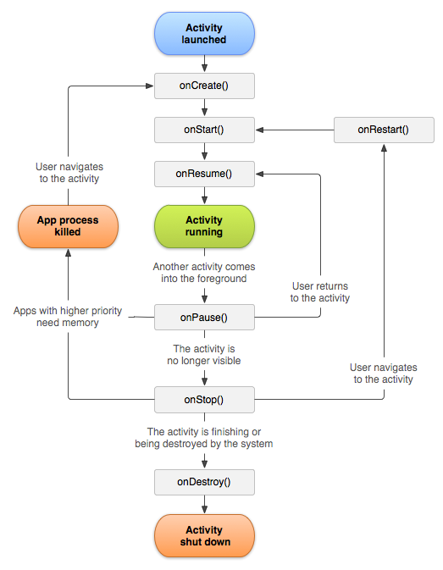
Android Activity Life Cycle
http://developer.android.com/intl/zh-tw/reference/android/app/Activity.html

Slide 11
What is JNI (Java Native Interface)
Communicate with Java and C by jni.h
Java call c
C call Java
http://androidxref.com/6.0.1_r10/xref/libnativehelper/include/nativehelper/jni.h
Remember extern “C” in JNI function if built from C++

Slide 12
JNI in Java
If the JNI so is libTestJNI.so
static {
System.loadLibrary(TestJNI);
}
public native void DoSomething();
public native void DoSomething(int argA, int argB);
public static native void …
Eclipse
right click your Andorid project -> Andorid Tools -> Add Native Supports
See the demo, Focus on Project Properties
c/c++ build, c/c++ general->Path and Symbol

Slide 13
NDK Build
Application.mk
ABI
Andorid.mk
http://developer.android.com/intl/zh-tw/ndk/guides/android_mk.html
http://developer.android.com/intl/zh-tw/ndk/guides/application_mk.html
http://developer.android.com/intl/zh-tw/ndk/guides/ndk-build.html

Slide 14
Native Remote Debugger
Android also has native application debugger by using ndk-gdb
Current has issue in 64-bit abi
Can google search how to debug native application

Slide 15
NDK Development Flow
Java Side
Create Activity or Service class
Create Java native function in Java class
Java class, System.loadLibrary(XXX.so)
C Side
JNI Implementation
JNI calls to native library

Slide 16
Demo
Go through the detail about eclipse operation
Android Project with jni, focus on project file hierarchy
jni -> ….
lib -> ….

Slide 17
Reference
http://developer.android.com/intl/zh-tw/training/index.html
http://developer.android.com/intl/zh-cn/guide/index.html
Android開發教學視頻https://www.youtube.com/watch?v=N0fovzCHZ-I&list=PLHOqLxXumAI-hCYIzsnn6LCmZHzEStuuh
https://magiclen.org/android-jni/
Using the NDK with Android* Studio
https://www.youtube.com/watch?v=okLKfxfbz40
http://blog.xuite.net/yang44/omap3730/53870340-ubuntu%E4%BD%BF%E7%94%A8adb+devices%E9%A1%AF%E7%A4%BAno+permissions

Slide 18
Thanks for your attention

